Slide 1


📊 Internship and Placement Trends Analysis
(Using Data Analytics and Visualization)

Slide 2


Team Members
2310030415 - BAIRI SRAVYA GOUD
2310030222 - ALLU SAHITHI
2310030284 - RANGU SOWMYA
2310030327 - GUNDLA AASHRITHA
2310039457 - JAKKULA HAASINI

Slide 3

Introduction
1
Internships and placements are key steps in every student's career journey.
Understanding hiring patterns helps students prepare better.
2
It shows:
Top hiring companies
Popular job roles and domains
Package and stipend trends
Skill requirements
3
Visual tools like charts and dashboards make insights clear and easy to understand.
Useful for students, faculty, and placement cells to make data-driven decisions.

Slide 4
Problem Statement
Students often lack clarity on hiring trends.
It's hard to know which roles, domains, or skills are most in demand.
Placement cells need data to plan better training programs.
No central source to view past internship/placement records.

Slide 5
Objectives
Analyze internship and placement data from past years.
Identify:
Most recruited branches
Top companies and roles
Average packages and stipends
Trends in demand (domain-wise)
Visualize data for easy understanding and comparison.

Slide 6
Data Collection
Sources:
College placement records
Internship reports
Survey forms, LinkedIn, or Glassdoor (optional)
Data Fields:
Year, Student Branch, Company, Role
Domain, Package, Stipend, Duration

Slide 7
Tools and Technologies
Python – Data analysis with Pandas, NumPy
Matplotlib / Seaborn / Plotly – Data visualization
Tableau / Power BI – Dashboard creation
Excel – Preprocessing (optional)

Slide 8
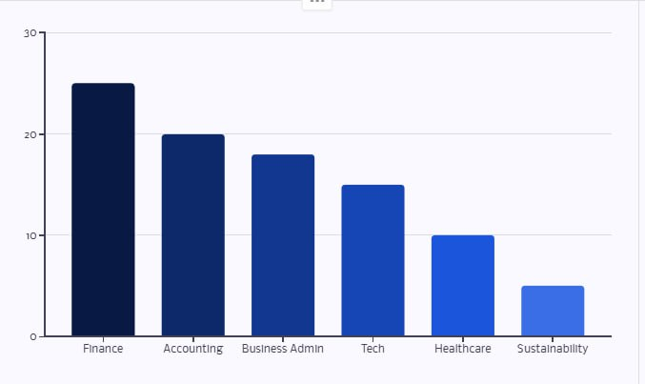
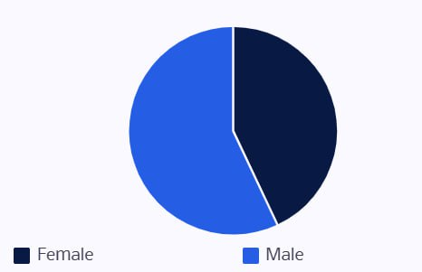
Visualizing Trends
Finance, accounting, and business administration continue to lead in internship opportunities. Growth in tech, healthcare, and sustainability indicates evolving industry demands. Female interns, while increasing, still represent a smaller share compared to the overall student population.

Slide 9
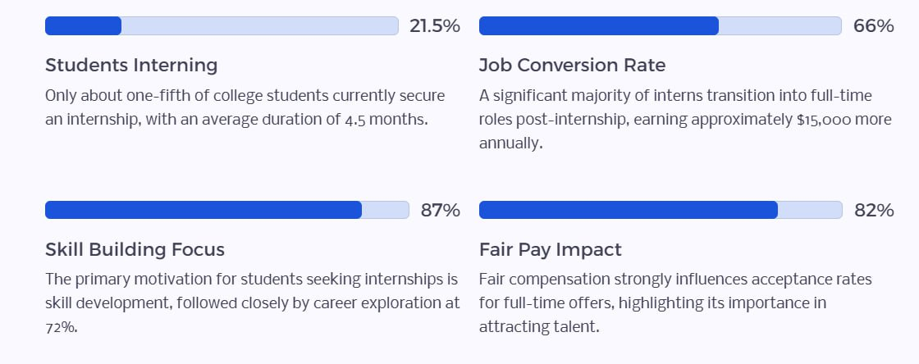
Case Study - I
Key Internship Statistics -2025

Slide 10
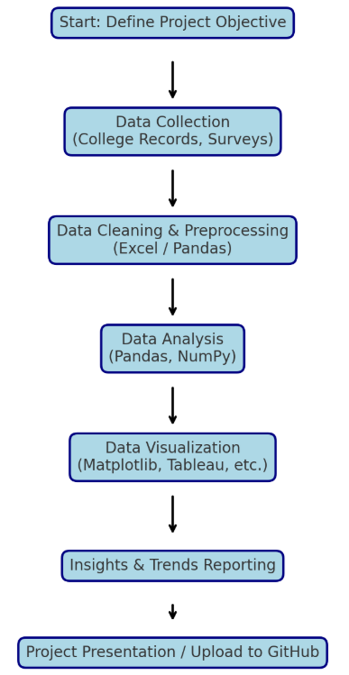
Flow Chart

Slide 11
Thank You

